Slide 1

STAGE 01 · PROBLEM
STAGE 02 · PIPELINE
STAGE 03 · DISCOVERY
STAGE 04 · EVALUATION
STAGE 05 · DECISION TOOL
QIYAS AI HACKATHON · CROP YIELD REGRESSION
Predicting Crop Yield Before Planting Decisions
Ethiopian smallholder regression · five regions · five crops
Can we predict crop yield before planting using only information available at or before planting time?
Inputs · plot survey data · regional weather · market prices
TARGET:YIELD_TONS_PER_HA
FOR EACH LEADERBOARD PLOT, USING ONLY INFORMATION KNOWN AT OR BEFORE PLANTING TIME.
Notes:
Introduce the team and state the core hackathon objective: predicting plot yield in tons per hectare before planting takes place, without data leakage.

Slide 2
QIYAS HACKATHON · 5-MEMBER TEAM
TEAM FARM - 5 MEMBERS
QIYAS HACKATHON
Desalegn Mengsitu
Abreham Cheru
Regina Giovanni
Henok Solomon
Mohammed Omer
Team Farm
SUBMITTED ON: October 6, 2026

Slide 3
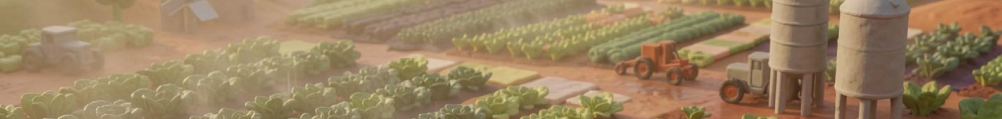
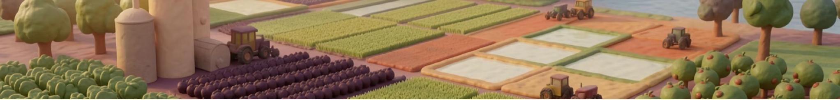

Data sources
PLOT SURVEY
15,090 plots · 2021–2024 · region · crop · planting information · plot characteristics
REGIONAL WEATHER
5 regions · 4 years · 12 months/year · rainfall · temperature · humidity
MARKET PRICES
5 crops · 5 regions · 4 years · market price · used for revenue estimation

Slide 4
STAGE 01 · PROBLEM
STAGE 02 · PIPELINE
STAGE 03 · DISCOVERY
STAGE 04 · EVALUATION
STAGE 05 · DECISION TOOL
Three exports → one trustworthy modeling table
Data-quality problems
Join logic
PLOT TABLE · LEFT JOIN ↓ SEASONAL WEATHER ↓ PRICE DATA ↓ CLEAN MASTER
REGION LABELS: 4+ casing/label variants and abbreviations such as AMH/SOM
Monthly regional weather becomes one season-level row per plot. Growing-season rule: planting month + following 3 months, including year wraparound.
CROP LABELS: Tef / teff spelling mismatch
MISSING VALUES: -999 and -999.0 sentinels
Join audit
PRICE UNITS: Birr/kg vs Birr/quintal
Weather full-window match: 80.63%
Price match: XX.X%
Rows before: [INSERT]
Rows after: [INSERT]
Unmatched handling: [INSERT]
Notes:
Walk through the raw sources, the growing-season aggregation rule, and the join audit metrics. Reassure judges that prices are held separate for revenue evaluation only.

Slide 5
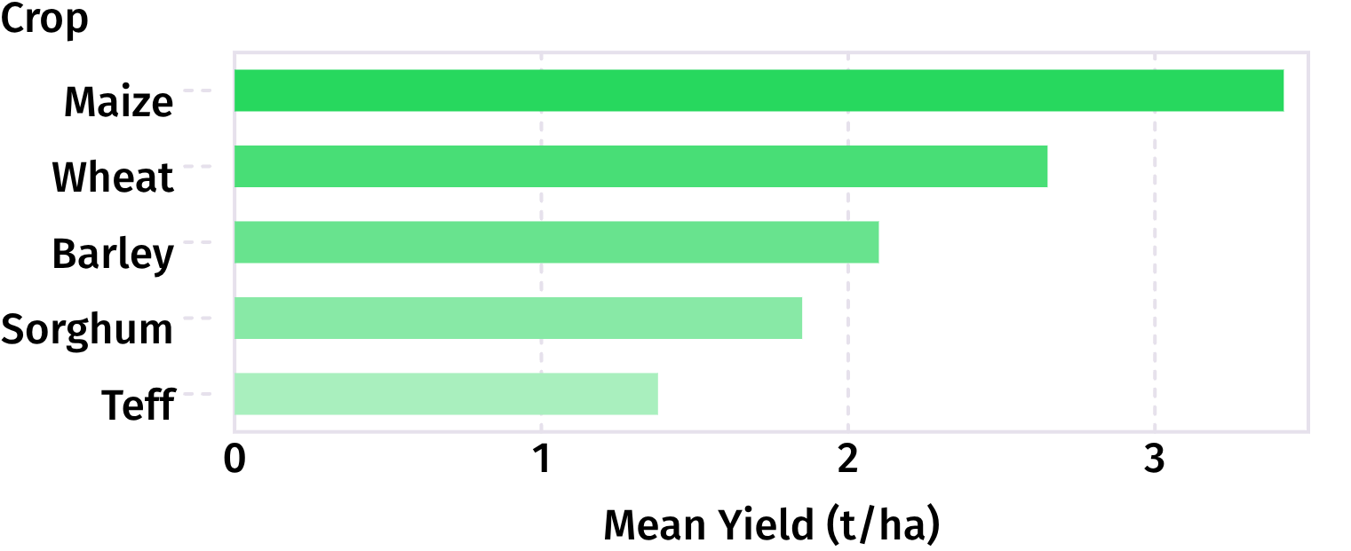
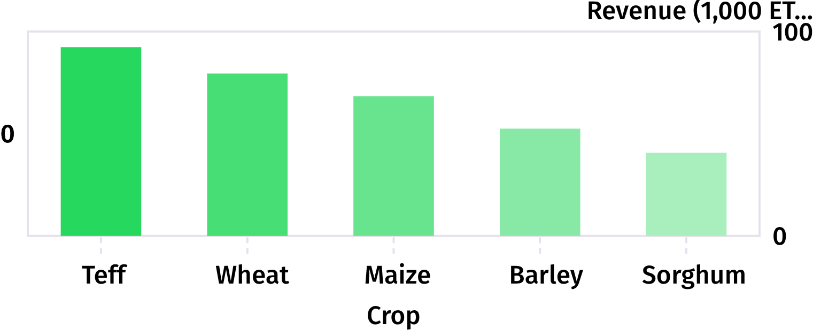
STAGE 01 · PROBLEM
STAGE 02 · PIPELINE
STAGE 03 · DISCOVERY
STAGE 04 · EVALUATION
STAGE 05 · DECISION TOOL
The data reveals where yield and value move together
High yield does not always maximize gross value; prices and regional risk reshape smallholder margins.
FIGURE 1 · MEAN YIELD BY CROP (TONS / HA)
FIGURE 2 · ESTIMATED REVENUE BY CROP (1K ETB / HA)
TAKEAWAY: Maize has the highest average yield at 3.90 t/ha, while teff is lowest at 2.00 t/ha — a 1.90 t/ha gap across crops.
TAKEAWAY: Teff has the lowest average yield at 2.00 t/ha, yet generates the highest estimated gross revenue at ≈152K ETB/ha — showing that yield alone does not determine economic value.
Agronomic vs economic reality: Revenue / ha = yield × 10 quintals/ton × price / quintal. Teff has the lowest physical yield per hectare but, at market prices, leads total per-hectare gross revenue. [INSERT ONE-SENTENCE DOMAIN MEANING]
Notes:
Contrast physical tonnage with farmgate revenue. Explain the commercial trade-off smallholders face when choosing between hardy staple calories (like maize or sorghum) and cash-value crops (like teff).

Slide 6
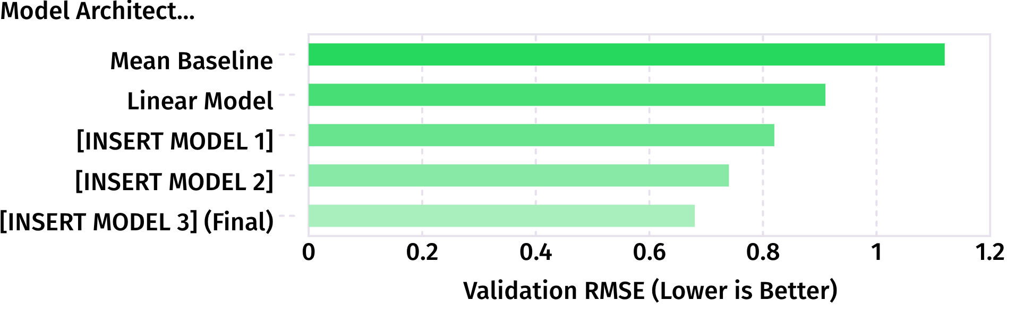
STAGE 01 · PROBLEM
STAGE 02 · PIPELINE
STAGE 03 · DISCOVERY
STAGE 04 · EVALUATION
STAGE 05 · DECISION TOOL
Weather features must prove value on held-out evaluation
Leak-free 5-fold cross-validation · seed [INSERT RANDOM SEED].
5-FOLD CV VALIDATION RMSE · TONS / HA
WEATHER ABLATION & FINAL METRICS
SELECTED CHAMPION MODEL
[INSERT MODEL NAME]
RMSE [INSERT] · MAE [INSERT] · R²= 0.886 ]
CONTROLLED WEATHER ABLATION
Without weather [INSERT RMSE] → with weather [INSERT RMSE] · delta [INSERT DELTA]
5-FOLD CV SPLIT [INSERT SPLIT] · RMSE [INSERT RMSE MEAN ± SD]
KEY TAKEAWAY
Pre-season cumulative rainfall and early moisture indices meaningfully reduced variance in rainfed highland plots.
Notes:
Present the model progression from dummy mean baseline to your tuned champion model. Highlight the explicit ablation test confirming that weather features provided a genuine predictive signal.

Slide 7
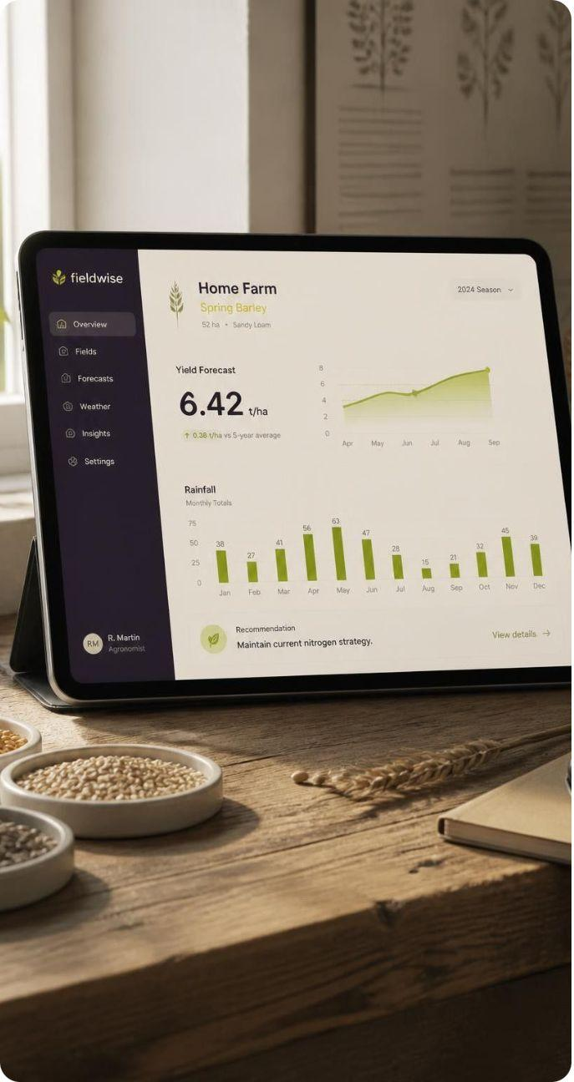
STAGE 01 · PROBLEM
STAGE 02 · PIPELINE
STAGE 03 · DISCOVERY
STAGE 04 · EVALUATION
STAGE 05 · DECISION TOOL
From prediction error to a working decision tool
Translating regression outputs into an accessible planting advisory application for extension workers.
LEADERBOARD SCORE
ERROR RESIDUAL ANALYSIS · HARDEST SUBGROUPS
[INSERT]
[INSERT D7 FINDING: highest residual error crops and regions].
Final test set RMSE on held-out plots.
LIVE DEPLOYED ADVISORY APPLICATION
Model outputs: Expected yield (t/ha), confidence interval, estimated gross revenue (ETB), and historical weather context.
Next technical step: [INSERT ONE IMPROVEMENT] · Operational limitation: [INSERT ONE LIMITATION]
Run command: [INSERT DEMO URL OR LOCAL RUN COMMAND]
User inputs: Region, plot size, anticipated planting month, and selected crop.
Notes:
Conclude with the real-world deployment: explain what the extension worker enters into the app, how yield translates into economic advisory, and what error patterns remain to be tackled next.

Slide 8
THE END
QIYAS HACKATHON
Thank you

